Slide 1
A1Chemistry
Hydrocarbon reactions: Addition and substitution

Slide 2
Review
All hydrocarbons, including benzene, will undergo combustion to produce carbon dioxide and water (or carbon monoxide and water in limited oxygen).

Slide 3
Write a balanced equation (6 marks) :
Combustion of ethane in excess oxygen
Combustion of methane in air
Combustion of methyl propane in limited oxygen

Slide 4
Learning Intentions
alkanes, alkenes and benzene undergo characteristic reactions such as combustion, addition reactions for alkenes and substitution reactions for alkanes and benzene

Slide 5
Success criteria
Write balanced chemical reactions for various addition and substitution reactions
Name halohydrocarbons
Apply Markovnikov’s Rule

Slide 6
Key words
addition
substitution
halogenation
hydrohalogenation
Hydrogenation
‘Markovnikov’s Rule’

Slide 7
Addition
Only occurs with alkenes (=)
The double bond breaks, allowing two extra atoms (halogen or hydrogen) to add to the molecule

Slide 8
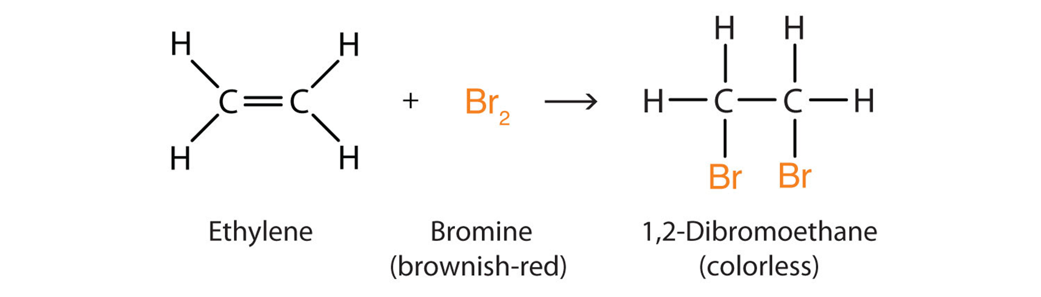
Halogenation

Slide 9
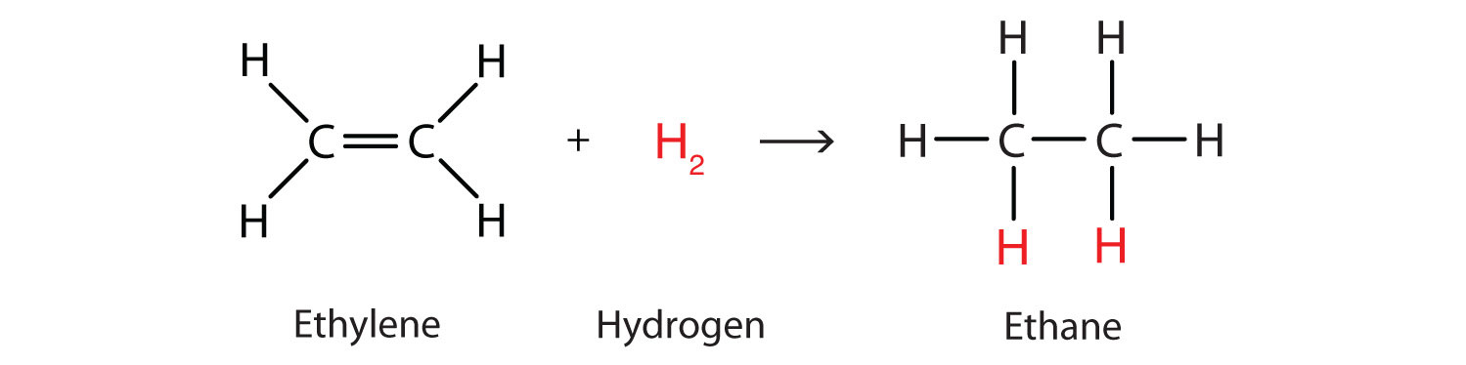
Hydrogenation

Slide 10
Hydrohalogenation

Slide 11
Markovnikov’s rule:
Hydrogens tend to bond to the carbon which has the most hydrogens already, the halogen tends to bond to the carbon with the least hydrogens already.

Slide 12
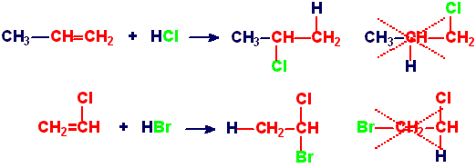

Slide 13
Substitution
Only occurs in alkanes
Halogen displaces a hydrogen by disrupting the C – H bond

Slide 14
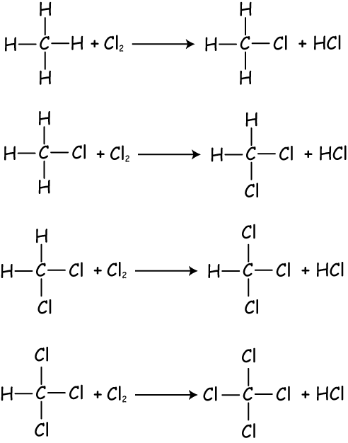

Slide 15
Success criteria
Write balanced chemical reactions for various addition and substitution reactions
Name halohydrocarbons
Apply Markovnikov’s Rule

